Slide 1
Power BI Financial Analyst
Sales Calculation
Analyzing Sales
Visualizing Trends
Shahzaib Hamid
AI Sciences Instructor

Slide 2
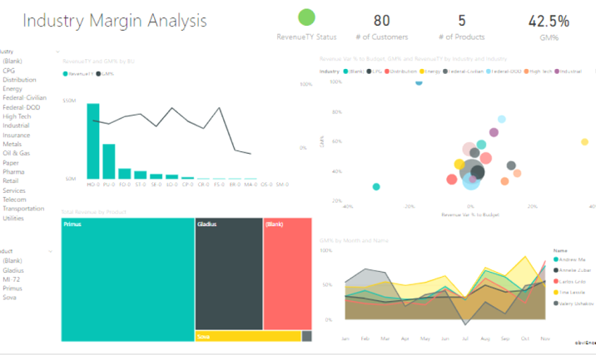
In this Module
Hands on
Getting Started
Developing data
Analysis
Visualization
Understanding Data
GL Usage
Data in Power BI
Calculating Sales
Matrix Formatting
Quarterly
Monthly
Visualizing Trends
Charts
Data Slicer

